Slide 1




Astronomy 1020 chapter 21
Clayton State University
Slides for Astronomy textbook from OpenStax
https://openstax.org/books/astronomy/

Slide 2
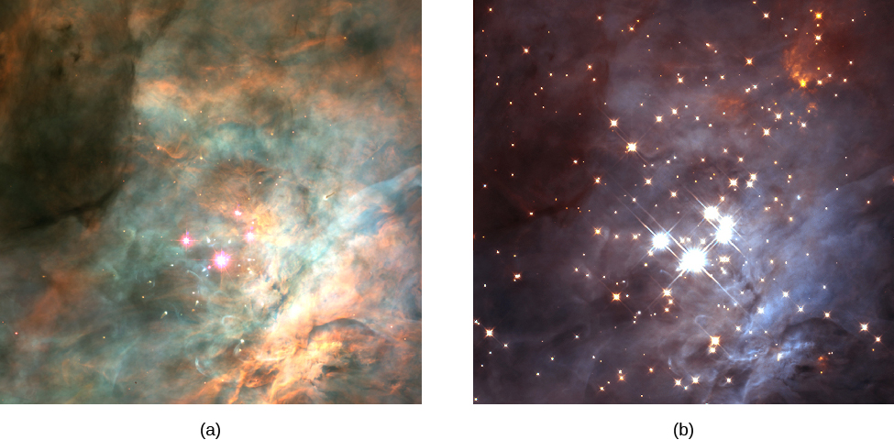
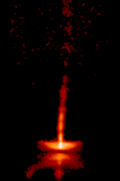
Star forming regions
The T Tauri star HH-30 shows ‘bullets’ of material propagating along a jet.
Credit: NASA, A. Watson (UNAM), K. Stapelfeldt (JPL), J. Krist (STScI) and C. Burrows (ESA/ STScI)
From the text: Figure 21.5
  Central Region of the Orion Nebula. The Orion Nebula harbors some of the youngest stars in the solar neighborhood.
  At the heart of the nebula is the Trapezium cluster, which includes four very bright stars that provide much of the energy that causes the nebula to glow so brightly.
  In these images, we see a section of the nebula in (a) visible light and (b) infrared.
  The four bright stars in the center of the visible-light image are the Trapezium stars. Notice that most of the stars seen in the infrared are completely hidden by dust in the visible-light image.
  (credit a: modification of work by NASA, C.R. O’Dell and S.K. Wong (Rice University); credit b: modification of work by NASA; K.L. Luhman (Harvard-Smithsonian Center for Astrophysics); and G. Schneider, E. Young, G. Rieke, A. Cotera, H. Chen, M. Rieke, R. Thompson (Steward Observatory, University of Arizona))

Slide 3
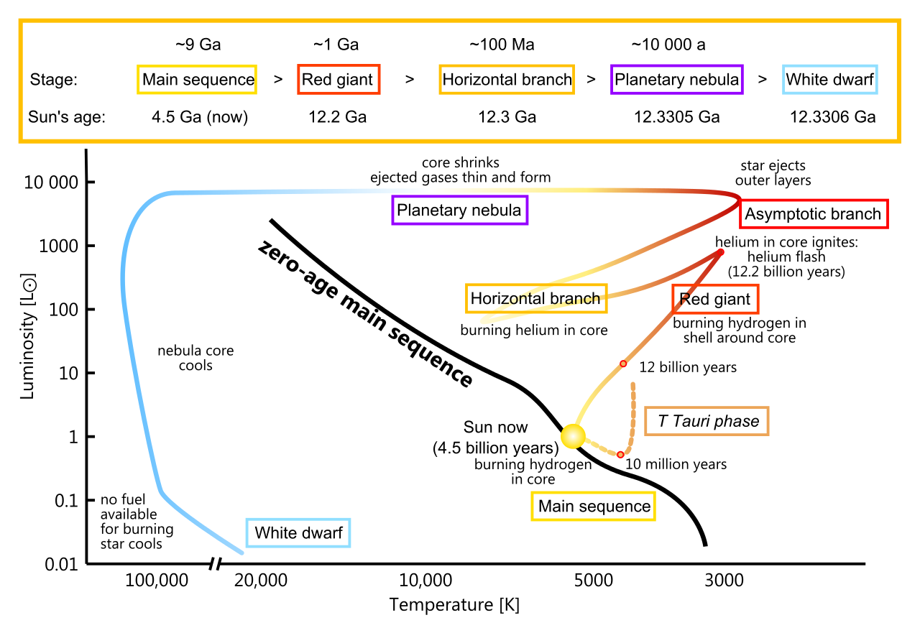
Evolution on H-R for the Sun

Slide 4

Star Formation

Slide 5
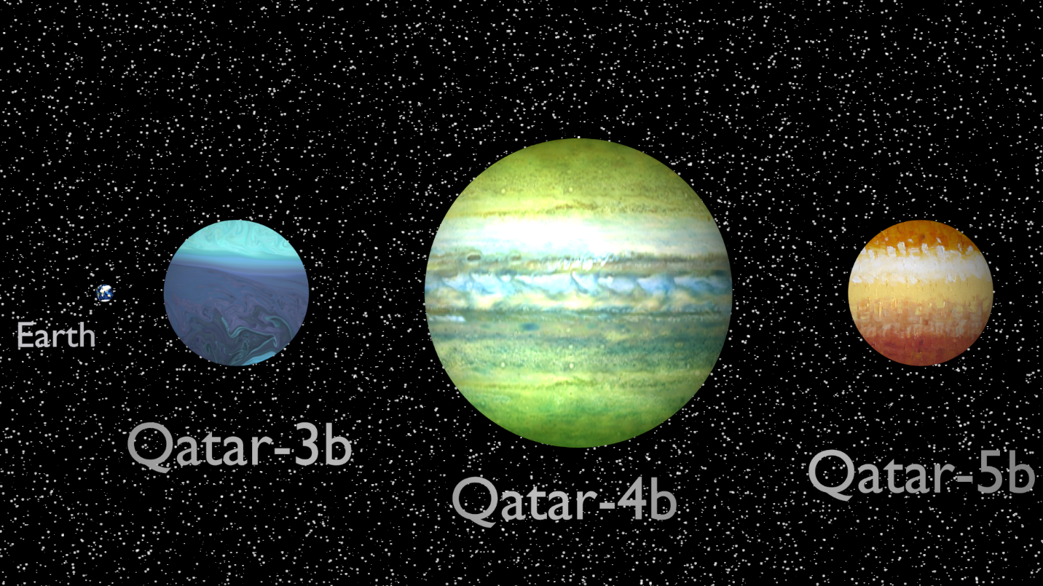
Extra-solar planets
Orbiting other stars
Can not be resolved (seen) due to distance and small size
All single stars have at least one, some planets can even exist in binary systems (rare)
Very difficult to discover and study
First to be detected are large and fast-orbiting ones.
(false colors, artist’s perception.)
The three new Exoplanets have sizes between 1 and 1.5 times that of Jupiter (12 to 17 times larger than the Earth) and temperatures between 1400 and 1700 Celsius, completing full orbits around their stars in times ranging between 1.8 and 2.9 Earth’s days.

Slide 6
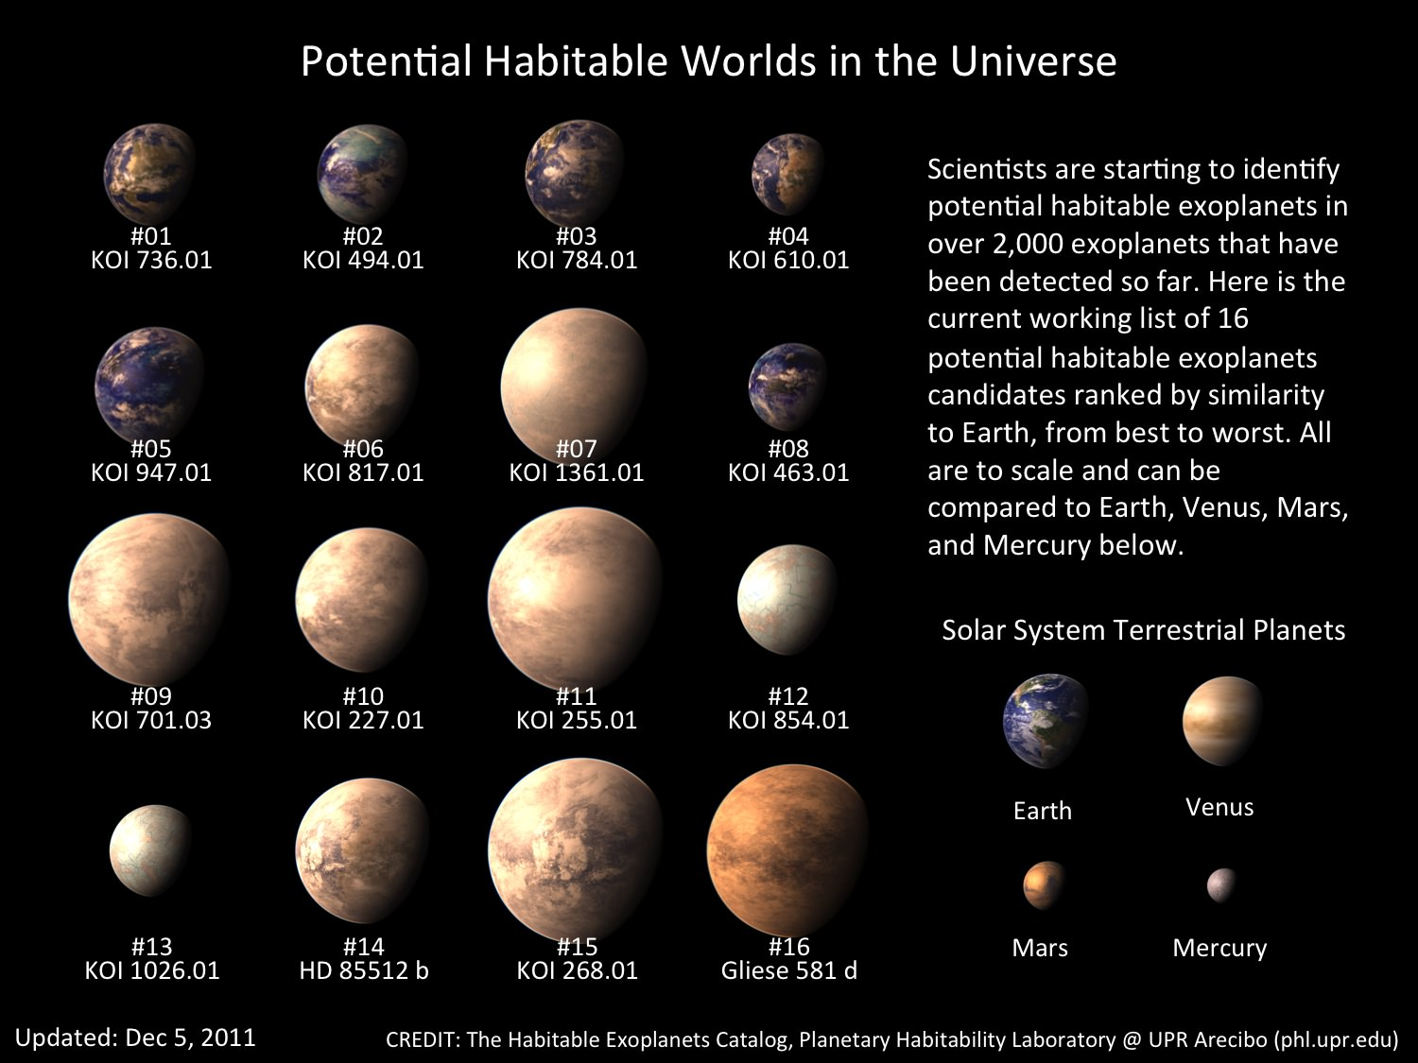
Methods for finding extrasolar planets
radial velocity method
transit photometry
pulsation timing
Microlensing
direct imaging

Slide 7
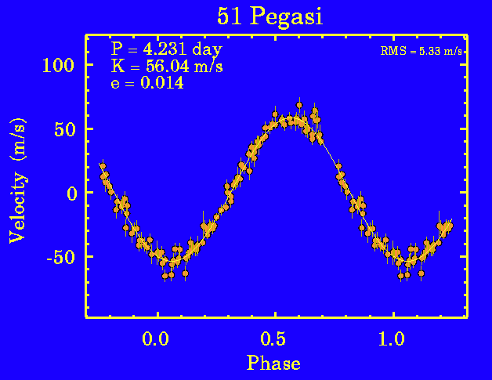
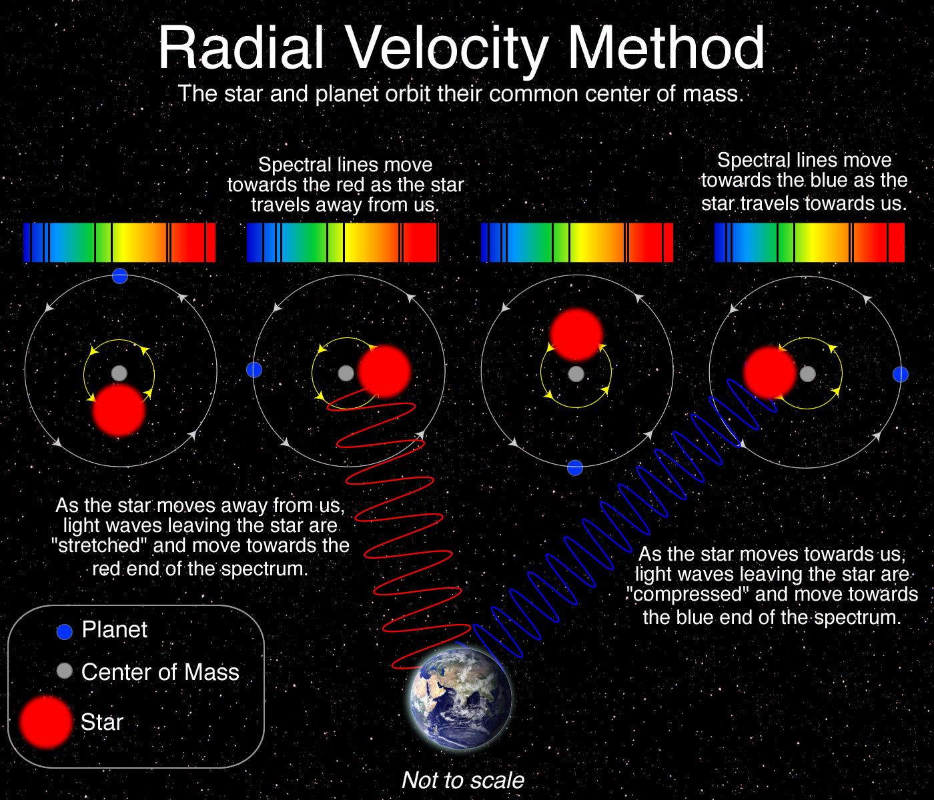
Radial velocity
Works well for large planets that have short orbital period
Very hard to detect Earth-like

Slide 8
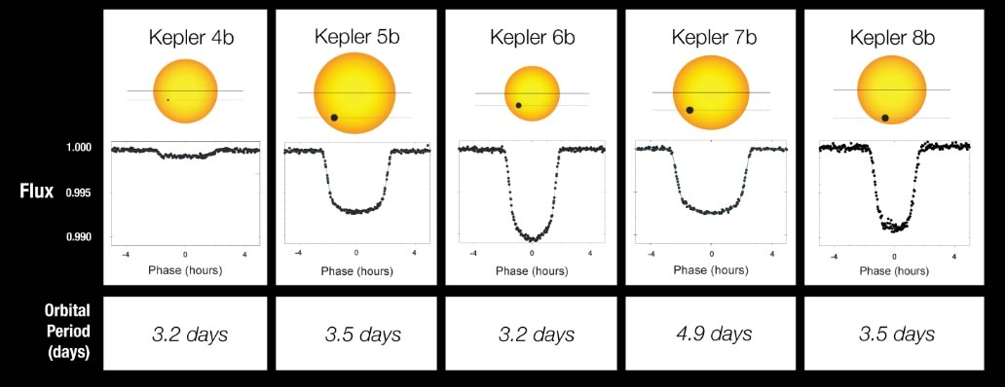
Transit photometry
Works well with large planets/small stars, and short orbital periods

Slide 9
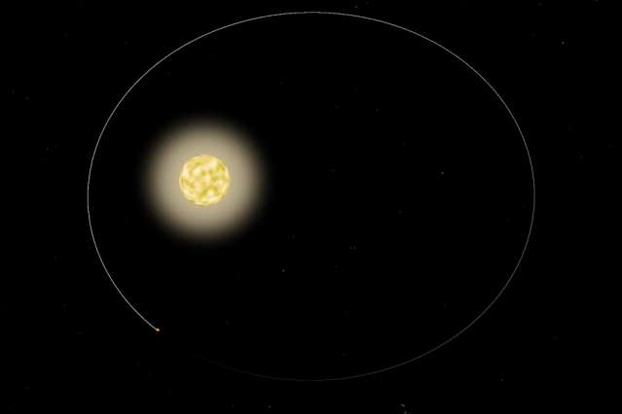
Pulsation timing
For the first time, -observed a star pulsing in response to its orbiting planet.
HAT-P-2, is about 400 light years from Earth and is circled by a gas giant measuring eight times the mass of Jupiter.
The planet, named HAT-P-2b, tracks its star in a highly eccentric orbit, flying extremely close to and around the star, then hurtling far out before eventually circling back around.
The researchers analyzed more than 350 hours of observations of HAT-P-2 taken by NASA's Spitzer Space Telescope and found that the star's brightness appears to oscillate ever so slightly every 87 minutes. In particular, the star seems to vibrate at exact harmonics, or multiples of the planet's orbital frequency—the rate at which the planet circles its star
Works only for very massive planets on eccentric orbits

Slide 10
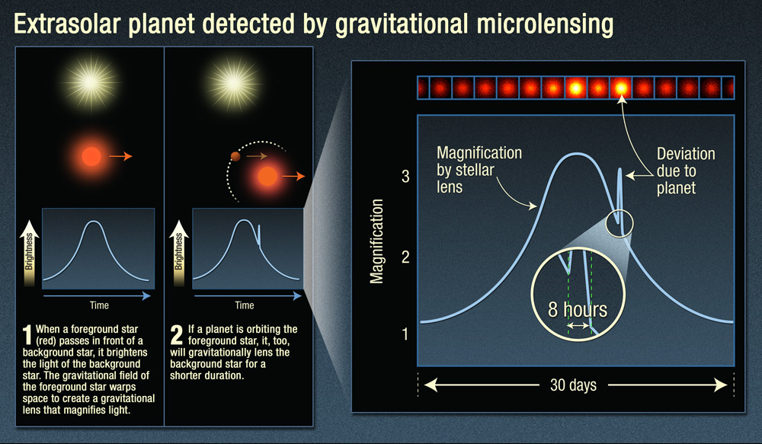
Microlensing
Works best with massive planets!

Slide 11
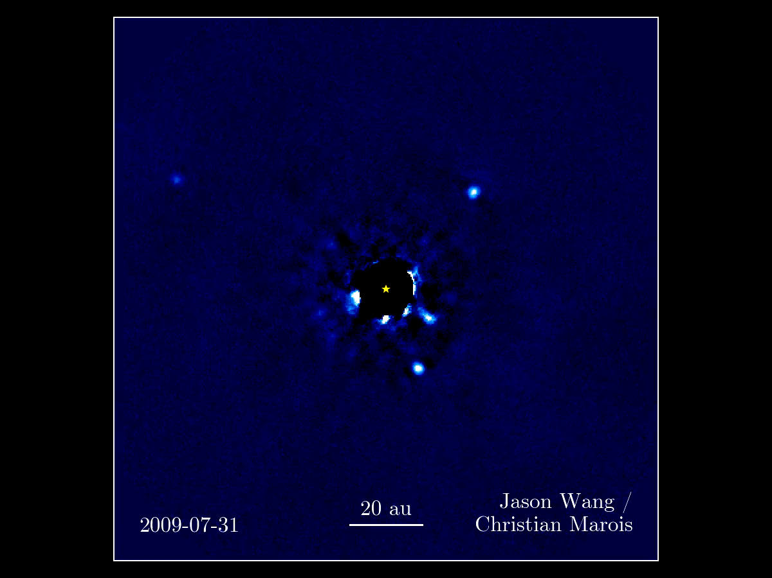
Direct imaging
This movie of four planets more massive than Jupiter orbiting the young star HR 8799 is a composite of sorts, including images taken over seven years at the W.M. Keck observatory in Hawaii
Works only on nearby bright stars with large planers that have high reflection (clouds?). Can detect far planets with long period. No actual planet image!

Slide 12
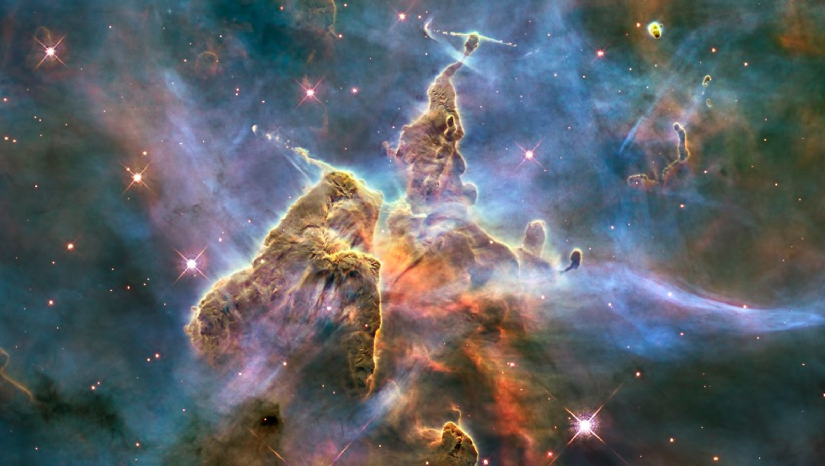
Any Questions?

